Slide 1

(T2) Threads: Mutual Exclusion (mutex)
Ion Mandoiu
Laurent Michel
Revised by M. Khan, J. Shi and W. Wei

Slide 2
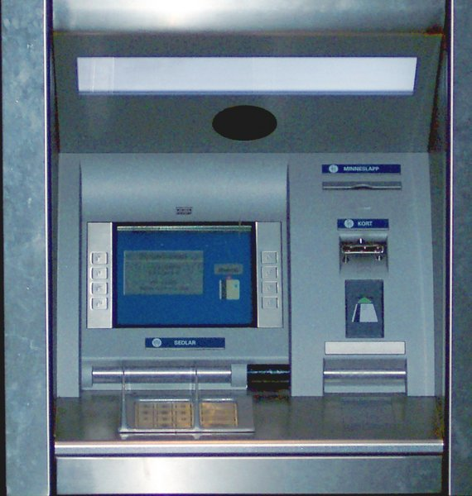
Review
So far
You learned how to create threads (pthread_create)
You learned how to terminate thread execution (pthread_exit)
You learned how to wait on threads (pthread_join)
You can carry out independent computations with threads
However, sharing is a problem
Remember the shared counter?
What if the shared counter is the balance on your bank account?

Slide 3
Overview
Basic Sharing
Mutual exclusion
Critical section
Mutex
Application
Concurrent access to shared data structures
Counter
Arrays
…

Slide 4
Mutual Exclusion
Objective
Protect shared resources
Only one thread can access the resources
Protocol
A set of procedures for accessing shared resources
Example:
Lock the resource while using it. Cannot lock if it is already locked.
Wait if the resource is already locked
Fact
Ask everyone nicely, and expect that everyone behaves

Slide 5

Protocol
Thread 1
I’d like to use variable “x”
<do something to x>
<continue doing it>
<almost done now!>
I’m done with variable “x”
Thread 2
I’d like to use variable “x”
SLEEPY TIME
WAKE UP!
<do something with x>
<continue doing it>
<almost done now!>
I’m done with variable “x”
critical
section
Waiting…
critical
section
Time

Slide 6
Race to critical section
Multiple threads race each other to get to critical section
Critical section is a code segment that accesses shared resources
One of them “wins” the race
Winner
acquires a “lock” first
executes critical section
releases the lock (unlock)
Loser
waits as the resource is locked
wakes up when it is its turn to get the lock
executes critical section
releases the lock

Slide 7


Protocol
Thread 1
I’d like to use variable “x”
<do something to x>
<continue doing it>
<almost done now!>
I’m done with variable “x”
Thread 1
lock variable "x"
<do something to x>
<continue doing it>
<almost done now!>
unlock variable "x"
x
x
Time

Slide 8
Protocol
Thread 1
I’d like to use variable “x”
<do something to x>
<continue doing it>
<almost done now!>
I’m done with variable “x”
Thread 1
lock variable "x"
<do something to x>
<continue doing it>
<almost done now!>
unlock variable "x"
x
x
Time

Slide 9
Mutex
The Lock is a POSIX abstraction
Called a Mutex (for MUTual Exclusion)
Provided by the operating system
Semantics
At most one thread can acquire the lock at any time
If a thread “loses” a race, it falls asleep
Sleepy threads wake up when the lock is released
We can use variable x in previous example to protect any critical sections
Notes:
Provider
The Operating System
Or through thread implementation
the lock is released

Slide 10
pthread mutex type and APIs
// define a mutex, a shared variable
// only one thread can lock it!
pthread_mutex_t mutex;
Functions
Initialize the Mutex
Destroy a Mutex we no longer need
Lock a Mutex
Unlock a Mutex
[Attempt to Lock a Mutex]

Slide 11
Initialization
#include <pthread.h>
int pthread_mutex_init(pthread_mutex_t * mutex,
const pthread_mutexattr_t * attr);
Initialize a mutex (i.e., allocate OS resources)
Return 0 on success
Example
typedef struct MyRecord {
pthread_mutex_t myLock;
int myValue;
} MyRec;
MyRec* makeARecord() {
MyRec* rec = (MyRec*)malloc(sizeof(MyRec));
pthread_mutex_init(&rec->myLock,NULL);
rec->myValue = 0;
return rec;
}
mutex attribute

Slide 12
Destruction
#include <pthread.h>
int pthread_mutex_destroy(pthread_mutex_t * mutex);
Release resources for lock
Return 0 on success
Example
typedef struct MyRecord {
pthread_mutex_t myLock;
int myValue;
} MyRec;
void freeARecord(MyRec* rec) {
pthread_mutex_destroy(&rec->myLock);
free(rec);
}

Slide 13
Lock / Unlock
#include <pthread.h>
int pthread_mutex_lock(pthread_mutex_t * mutex);
int pthread_mutex_unlock(pthread_mutex_t * mutex);
Enter/leave the critical section. Wait (asleep!) if mutex is locked
Return value 0 on success. (≠0? something went terribly wrong)
Example
typedef struct MyRecord {
pthread_mutex_t myLock;
int myValue;
} MyRec;
void incrementRecordValue(MyRec* rec) {
pthread_mutex_lock(&rec->myLock);
rec->myValue = rec->myValue + 1;
pthread_mutex_unlock(&rec->myLock);
}

Slide 14
Key Observations
Lock and Unlock come in pairs
You need ONE MUTEX per “thing” you wish to protect
That’s why we package the integer and the mutex in a struct
The mutex protects just that integer
And nothing else!
Lock is BLOCKING
Critical sections should be short
Why?
Locking incurs a big cost
Why?

Slide 15
Example 1
Fix the example we had issue

Slide 16
Example 2: counter ADT
A shared counter
That was the driving example
Make an ADT pairing mutex and counter
Have functions to manipulate the ADT
increase
decrease
resetToZero

Slide 17
Example 3: array
Sharing an array
Key decision: Locking Granularity
Lock the entire structure?
Lock individual parts?

Slide 18

Option 1
Idea
Wrap up the array in a structure
Have a single lock for the whole thing
Issues?

Slide 19
Option 2
Idea
Wrap up each value in a structure (value + lock)
Make an array of structures
Issues?

Slide 20
Study the remaining slides yourself

Slide 21
mutex_trylock()
#include <pthread.h>
int pthread_mutex_trylock(pthread_mutex_t *mutex);
If the mutex is not locked, it will succeed and lock
If the mutex is already locked
It will NOT block
It will return an error code
Purpose
Mix breed. It allows polling before blocking.
Sometimes, it is fine to use the shared resource later
Notes:
Why?

Slide 22
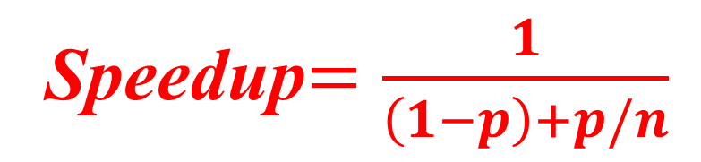
Amdahl’s Law
1
Serial code
Serial code that can be parallelized
1-p
p
Serial code
Parallel code
n CPU cores
1-p
p/n
Speedup$=\frac{1}{\left(1−p\right)+p/n}$

Slide 23
Practical speedup lower due to overhead
Serial code
Serial code that can be parallelized
Serial code
Parallel code
n CPU cores

Slide 24
Mutex Attributes?
A value of type pthread_mutexattr_t
An optional argument to create a mutex
APIs to
initialize attribute record (pthread_mutexattr_init())
destroy attribute record (pthread_mutexattr_destroy())
modify an attribute in attribute record (set type, get type, etc.)
Key property: mutex TYPE
How to deal with recursive lock?
What if other threads try to unlock?

Slide 25
Mutex Type (from the DOC)
PTHREAD_MUTEX_NORMAL
This type of mutex does not detect deadlock. A thread attempting to relock this mutex without first unlocking it will deadlock. Attempting to unlock a mutex locked by a different thread results in undefined behaviour. Attempting to unlock an unlocked mutex results in undefined behaviour.
PTHREAD_MUTEX_ERRORCHECK
This type of mutex provides error checking. A thread attempting to relock this mutex without first unlocking it will return with an error. A thread attempting to unlock a mutex which another thread has locked will return with an error. A thread attempting to unlock an unlocked mutex will return with an error.
PTHREAD_MUTEX_RECURSIVE
A thread attempting to relock this mutex without first unlocking it will succeed in locking the mutex. The relocking deadlock which can occur with mutexes of type PTHREAD_MUTEX_NORMAL cannot occur with this type of mutex. Multiple locks of this mutex require the same number of unlocks to release the mutex before another thread can acquire the mutex. A thread attempting to unlock a mutex which another thread has locked will return with an error. A thread attempting to unlock an unlocked mutex will return with an error.
PTHREAD_MUTEX_DEFAULT
Attempting to recursively lock a mutex of this type results in undefined behaviour. Attempting to unlock a mutex of this type which was not locked by the calling thread results in undefined behaviour. Attempting to unlock a mutex of this type which is not locked results in undefined behaviour. An implementation is allowed to map this mutex to one of the other mutex types.

Slide 26
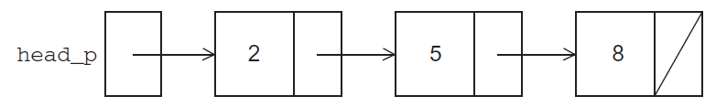
Sorted Linked List Example
typedef struct list_node_s {
int data;
struct list_node_s* next;
} LNode;

Slide 27
Testing membership
int member( int value, LNode* head_p) {
LNode* curr_p = head_p;
while( curr_p != NULL && curr_p->data < value )
curr_p = curr_p->next;
if( curr_p == NULL || curr_p->data > value )
return 0;
else
return 1;
}

Slide 28
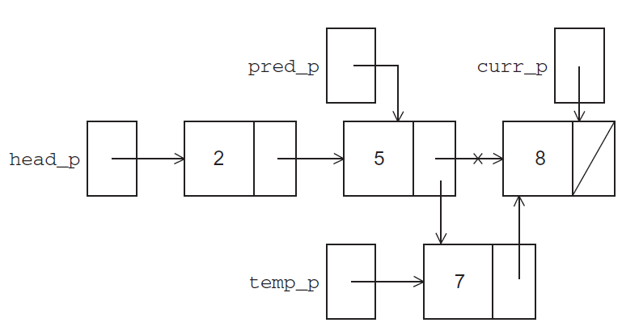
Inserting a new value

Slide 29
Inserting a new value
int insert( int value, LNode** head_pp) {
LNode* curr_p = *head_pp;
LNode* pred_p = NULL;
LNode* temp_p;
while( curr_p != NULL && curr_p->data < value ) {
pred_p = curr_p;
curr_p = curr_p->next;
}
if( curr_p == NULL || curr_p->data > value ) {
temp_p = (LNode*)malloc( sizeof(LNode) );
temp_p = value;
temp_p = curr_p;
if(pred_p == NULL) /* new first node */
*head_pp = temp_p;
else
pred_p->next = temp_p;
return 1;
} else /* value already in list */
return 0;
}

Slide 30
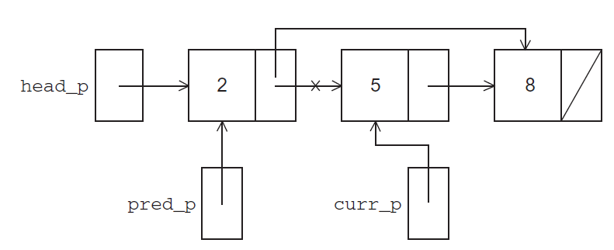
Deleting a value

Slide 31
Deleting a value
int delete( int value, LNode** head_pp) {
LNode* curr_p = *head_pp;
LNode* pred_p = NULL;
while( curr_p != NULL && curr_p->data < value ) {
pred_p = curr_p;
curr_p = curr_p->next;
}
if( curr_p == NULL || curr_p->data > value ) {
if(pred_p == NULL) { /* deleting first node in list */
*head_pp = curr_p->next;
} else {
pred_p->next = curr_p->next;
}
free(curr_p);
return 1;
} else /* value not in list */
return 0;
}

Slide 32
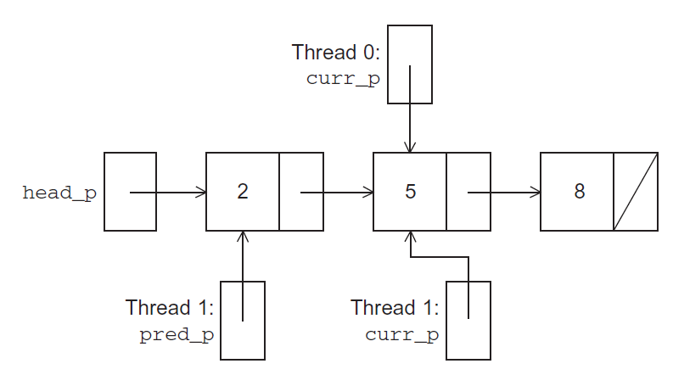
Simultaneous access by two threads?

Slide 33
Solution #1
Lock the entire list any time a thread attempts to access it
A call to each of the three functions protected by a mutex, e.g.,
Issues?
pthread_mutex_lock(&list_mutex);
member( value, head_p);
pthread_mutex_unlock(&list_mutex);

Slide 34
Solution #2
Instead of locking the entire list, we could try to lock individual nodes
A “finer-grained” approach
typedef struct list_node_s {
int data;
struct list_node_s* next;
pthread_mutex_t mutex;
} LNode;

Slide 35
Implementation of member with one mutex per node (1)
int member( int value, LNode* head_p) {
LNode* curr_p;
pthread_mutex_lock( &head_p_mutex );
curr_p = head_p
while( curr_p != NULL && curr_p->data < value ) {
if( curr_p->next != NULL )
pthread_mutex_lock( &(curr_p->next->mutex) );
if( curr_p == head_p )
pthread_mutex_unlock( &head_p_mutex );
pthread_mutex_unlock( &(curr_p->mutex) );
curr_p = curr_p->next;
}

Slide 36
Implementation of member with one mutex per node (2)
if( curr_p == NULL || curr_p->data > data ) {
if( curr_p == head_p )
pthread_mutex_unlock( &head_p_mutex );
if( curr_p != NULL )
pthread_mutex_unlock( &(curr_p->mutex) );
return 0;
} else{
if( curr_p == head_p )
pthread_mutex_unlock( &head_p_mutex );
pthread_mutex_unlock( &(curr_p->mutex) );
return 1;
}
}

Slide 37
Issues
More complex to implement
More memory to store the list
One mutex per node
Slower
Each time a node is accessed, a mutex must be locked and unlocked
Using more than one lock creates opportunities for DEADLOCK!

